Slide 1
Tools:
JDK ( 1.8)
IDE: Intellij ( Maven and TestNG plugins)
Browser Driver
Browser(e.g. Firefox, Chrome)
Maven

Slide 2
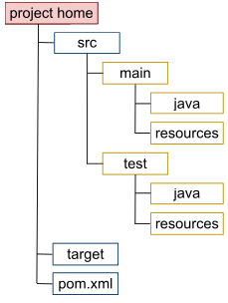
Configure automation testing project structure
Step1: Create a maven project(Maven projects are configured using a Project Object Model)
Project home: contains the pom.xml and all subdirectories
src/main/java: contains the deliverable Java source code
src/main/resources: contains the deliverable resources for the project, such as property files
src/test/java: contains the testing Java source code(e.g. TestNG test cases) for the project
src/test/resources: contains resources necessary for the testing
POM.xml file: describe dependencies and some plug-ins

Slide 3
Step 2: Add dependencies or required maven plug-ins:
Selenium
TestNG
Log4j
Extentreport
Maven-surefire ,maven-compiler plugin
Step3: Create some basic methods
‘launch browser’ method
‘Generate report for execution’ method
Acting method
Assertion method
…….

Slide 4
Demo:
Run single test case
Run multiple test cases

